Slide 1


Face2Exp: Combating Data Biases for Facial Expression Recognition
Dan Zeng¹, Zhiyuan Lin¹, Xiao Yan¹, Yuting Liu², Fei Wang¹, Bo Tang¹
¹Southern University of Science and Technology,
²JD.com, Beijing, China
Notes:
Hi, my name is Dan Zeng and will introduce our paper entitled “Face2Exp: combating data biases for facial expression recognition”.

Slide 2
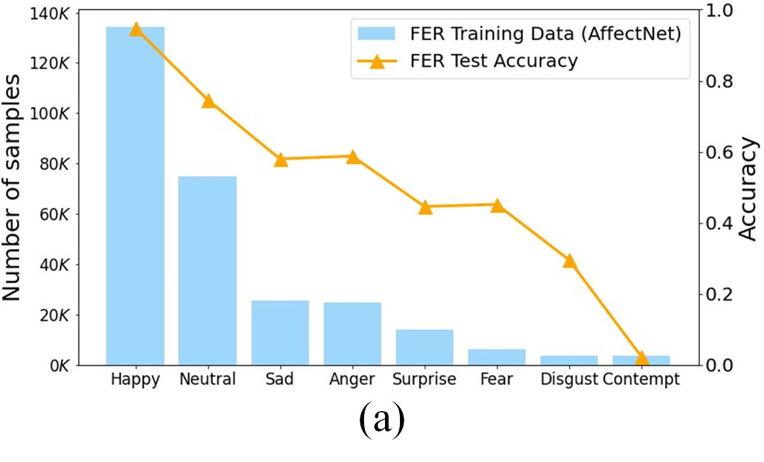
Challenges
Class imbalance in FER
Notes:
Facial expression recognition is challenging due to the class imbalance, which leads to poor test accuracy for the minority classes.

Slide 3
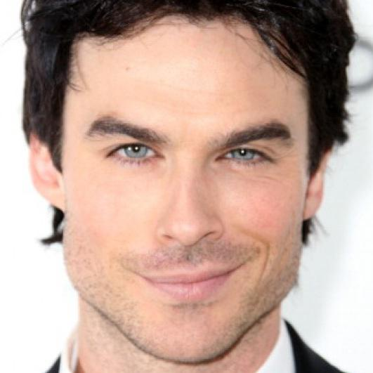
Challenges
Class imbalance in FER
Notes:
The bias is because some facial expression like contempt (出现人脸) is rare in daily life and is expensive to collect many samples.

Slide 4
Challenges
Class imbalance in FER
Existing solutions
Deep model design
Add side information
Remove ambiguous samples
Notes:
To tackle the class imbalance, some methods adopt deep classification network for feature extraction. Some methods use facial action unit or facial landmarks as side information for FER. Some methods improve FER performance by removing ambiguous samples from training set.

Slide 5
Challenges
Class imbalance in FER
Existing solutions
Deep model design
Add side information
Remove ambiguous samples
Our solution
Utilize large unlabeled FR datasets to enhance FER
Notes:
It is well-known that high-quality training data is crucial to the performance of a CNN model. As large-scale class-balanced FER dataset is expensive to acquire, we propose to utilize unlabeled large-scale face recognition datasets to enhance FER which is Orthogonal to existing FER methods .

Slide 6
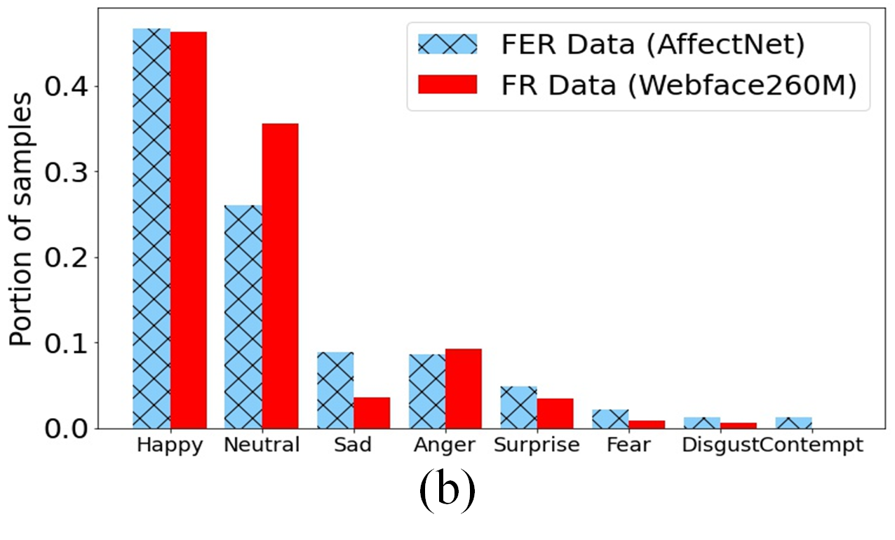
Challenges
Class imbalance in FER
Distribution mismatch
Notes:
However, this raises another data bias problem. Figure (b) shows that the class distributions of FR data and FER data mismatches.

Slide 7
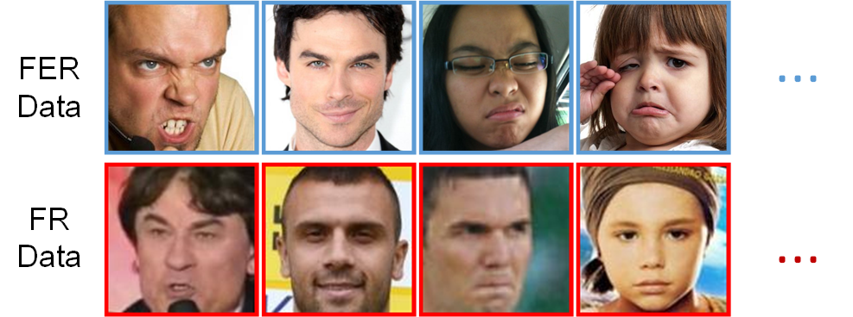
Challenges
Class imbalance in FER
Distribution mismatch
Anger
Contempt
Disgust
Sad
Notes:
Last but not the least, the image gap between FER data and FR data is large as FER data contains basic facial expressions and FR data has compound expressions.

Slide 8
Motivation
Learn prior expression knowledge from class balanced FER data
Learn rich expression knowledge from large unlabeled FR data
Circuit feedback mechanism
Notes:
Our motivations are: First, to solve class imbalance bias, we learn prior expression knowledge from class balanced FER data. We then use an adaptation network to learn rich expression knowledge from large unlabeled FR data. To combat the distribution mismatch between FR and FER data, we propose a circuit feedback mechanism to guide the learning on unbalance FR data.

Slide 9
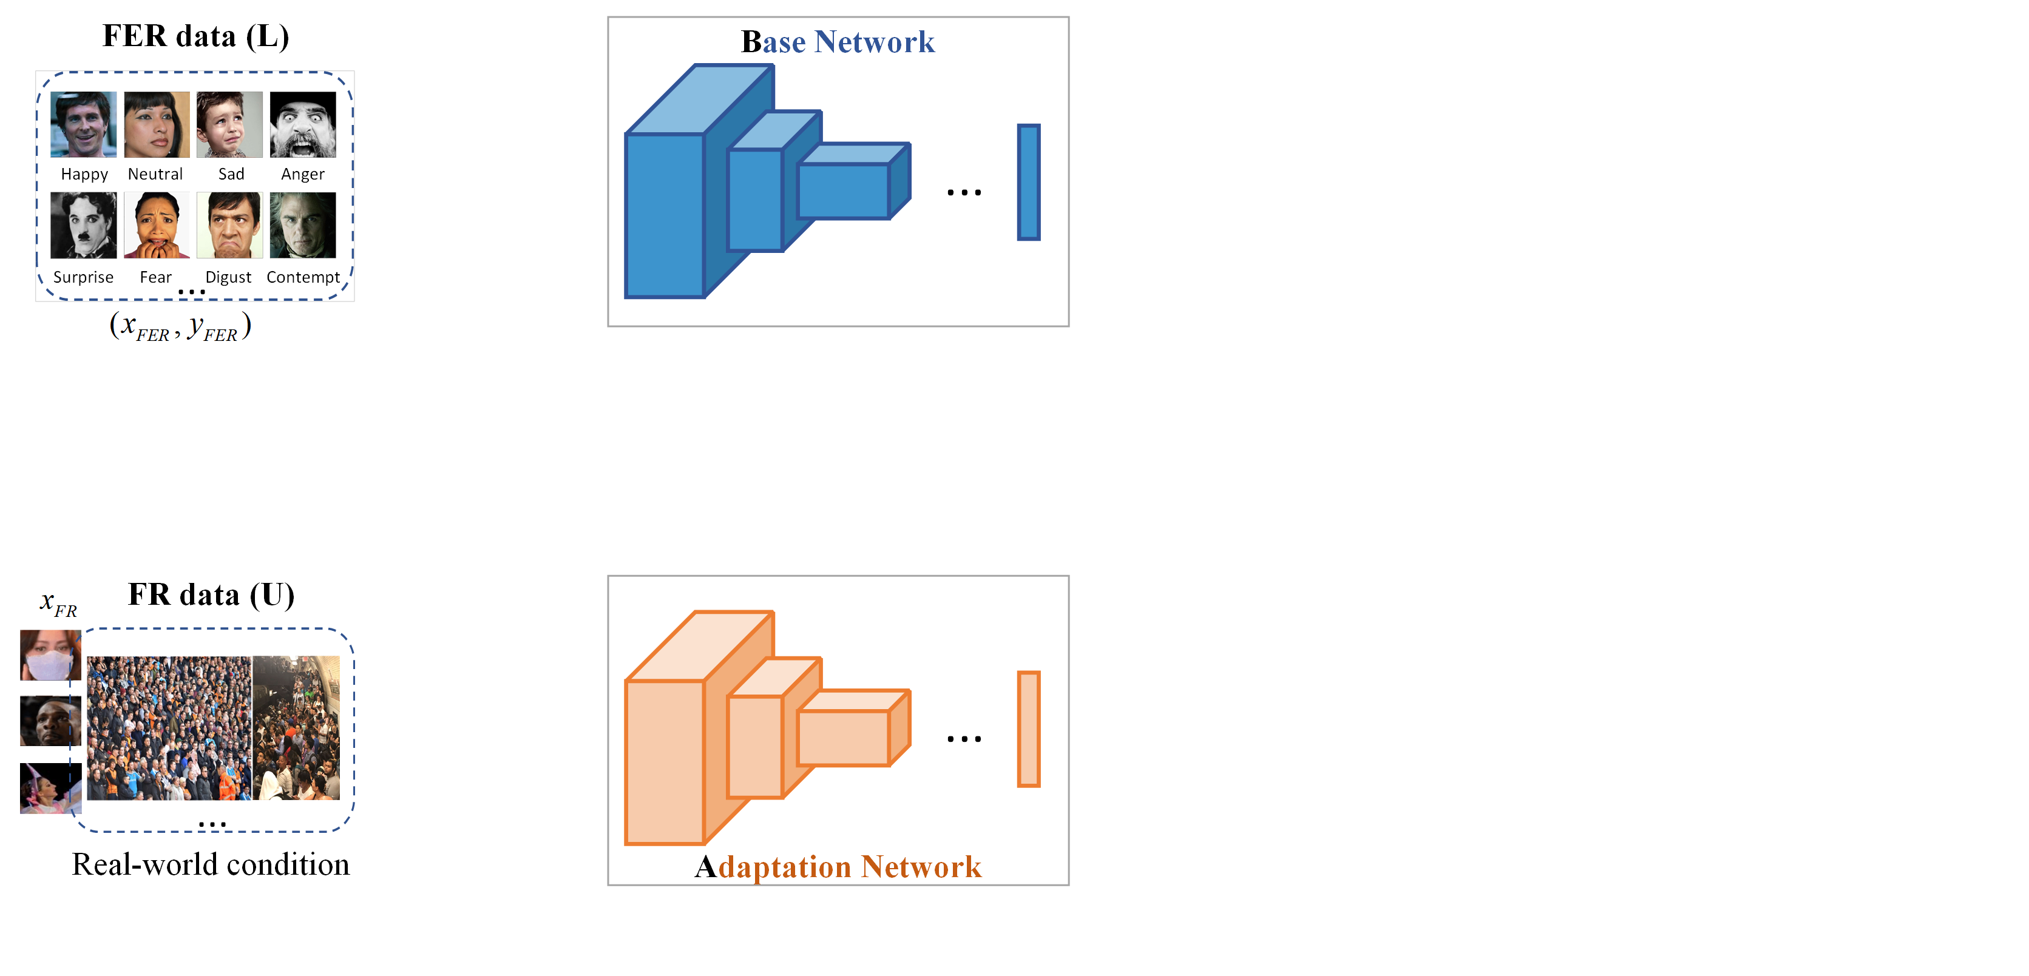
Meta-Face2Exp
Notes:
The proposed meta-face2exp consists of two networks, which are base network and adaptation network.

Slide 10
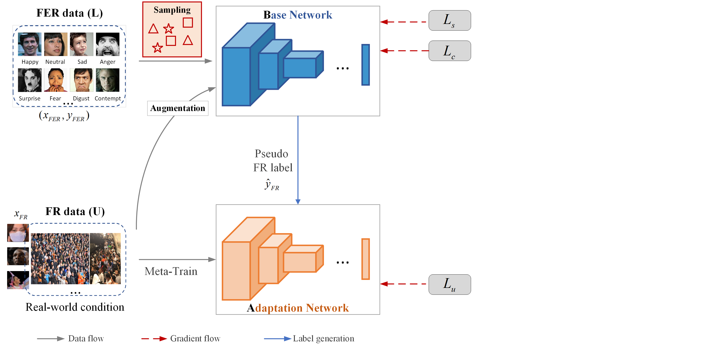
Meta-Face2Exp
Notes:
The adaptation network is trained with unsupervised learning loss高亮. The base network is trained with supervised learning 高亮 and consistent learning losses高亮. The gap between FR and FER Data leads to inaccurate pseudo labels, which hinders learning a good adaptation network.

Slide 11
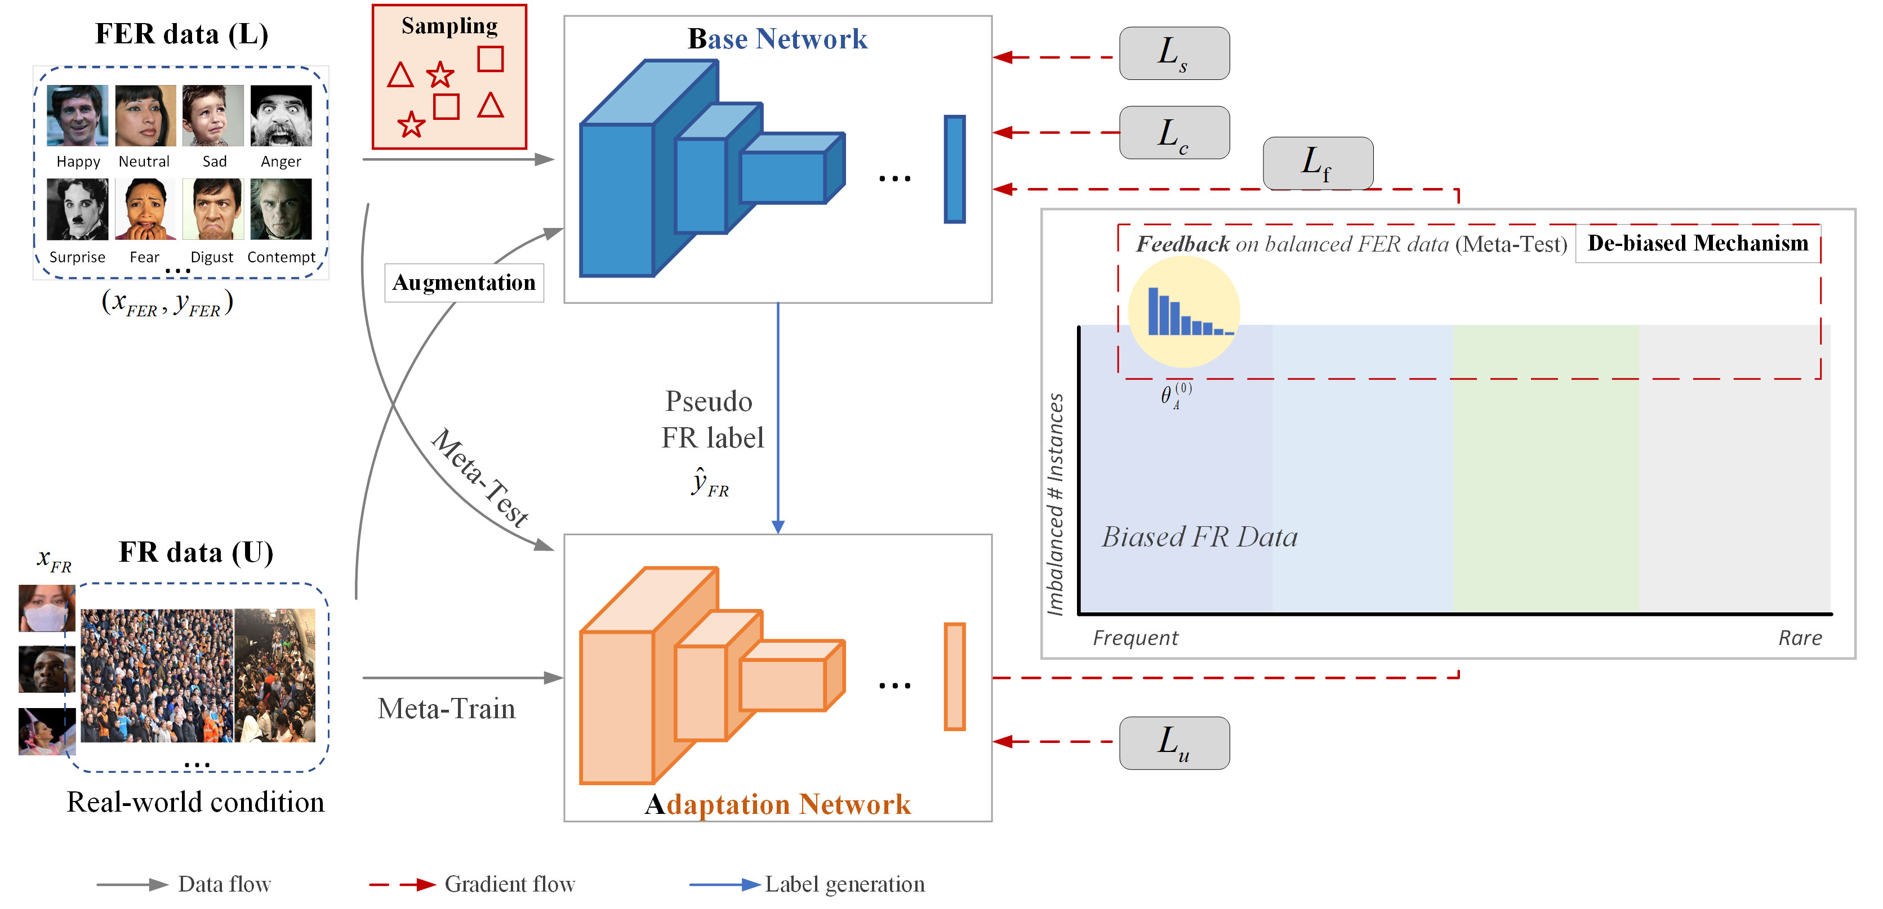
Meta-Face2Exp
Notes:
To tackle this issue, we use the feedback learning loss 高亮 to guide the learning of the adaptation network. Initially, it obtains biased accuracy on balanced FER data. Our de-biased mechanism informs the base network how good pseudo labels are by using the cognitive difference of the adaptation network on biased FR data and balanced FER data. As a result, the base network is gradually improved and can produce better pseudo labels for training the adaptation network in the next generation.

Slide 12
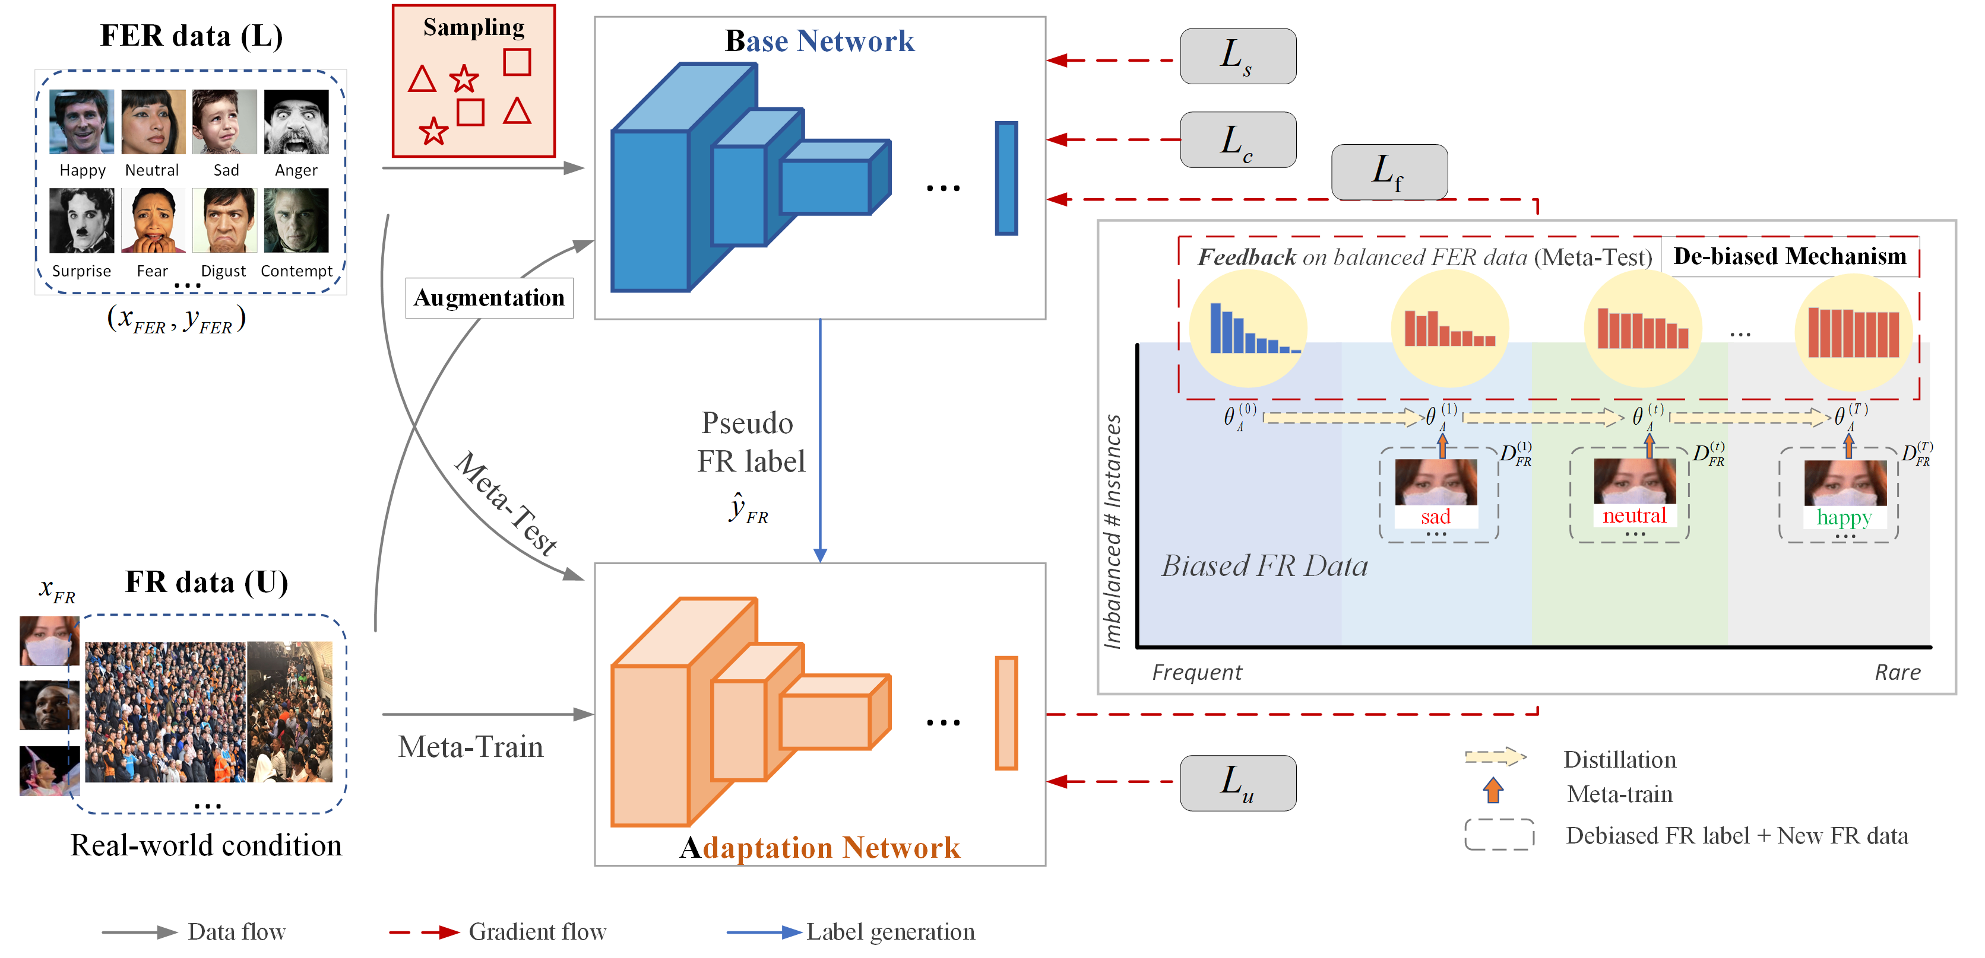
Meta-Face2Exp
Notes:
we can observe more and more flattened accuracy distribution in red. By design, meta-Face2Exp constantly complement each other to extract de-biased knowledge in FER task.

Slide 13

De-biased mechanism
$ℒ_{f}=f∙CE({\hat{y}}_{FR},ℬ(x_{FR};θ_{ℬ}))$
$f=η_{𝒜}∙(∇_{θ_{𝒜}^{\left(t+1\right)}}CE(y_{FER},𝒜\left(x_{FER};θ_{𝒜}^{\left(t+1\right)}\right))^{T}∙ ∇_{θ_{𝒜}^{\left(t\right)}}CE\left({\hat{y}}_{FR},𝒜\left(x_{FR};θ_{𝒜}^{\left(t\right)}\right)\right))$
Notes:
We go further to understand this de-biased mechanism.

Slide 14
De-biased mechanism
$ℒ_{f}=f∙CE({\hat{y}}_{FR},ℬ(x_{FR};θ_{ℬ}))$
$f=η_{𝒜}∙(∇_{θ_{𝒜}^{\left(t+1\right)}}CE(y_{FER},𝒜\left(x_{FER};θ_{𝒜}^{\left(t+1\right)}\right))^{T}∙ ∇_{θ_{𝒜}^{\left(t\right)}}CE\left({\hat{y}}_{FR},𝒜\left(x_{FR};θ_{𝒜}^{\left(t\right)}\right)\right))$
Gradients of the new network on debiased FER data.
Gradients of the old network on biased FR data.
Notes:
The first term is the gradients of the new adaptation network on balanced FER data. The second term indicates the gradients of the old adaptation network on biased FR data.

Slide 15
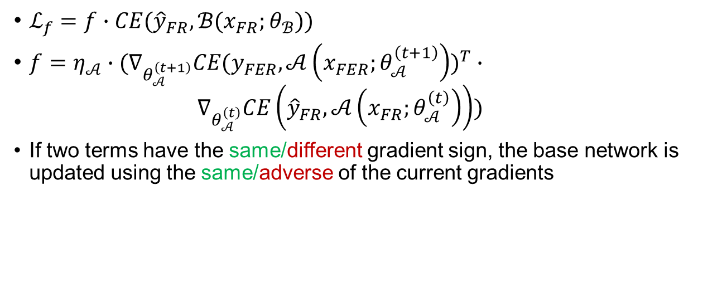
De-biased mechanism
$ℒ_{f}=f∙CE({\hat{y}}_{FR},ℬ(x_{FR};θ_{ℬ}))$
$f=η_{𝒜}∙(∇_{θ_{𝒜}^{\left(t+1\right)}}CE(y_{FER},𝒜\left(x_{FER};θ_{𝒜}^{\left(t+1\right)}\right))^{T}∙ ∇_{θ_{𝒜}^{\left(t\right)}}CE\left({\hat{y}}_{FR},𝒜\left(x_{FR};θ_{𝒜}^{\left(t\right)}\right)\right))$
If two terms have the same/different gradient sign, the base network is updated using the same/adverse of the current gradients
Notes:
The base network is updated using the same or adverse of the current gradients based on gradient sign of the two terms.

Slide 16
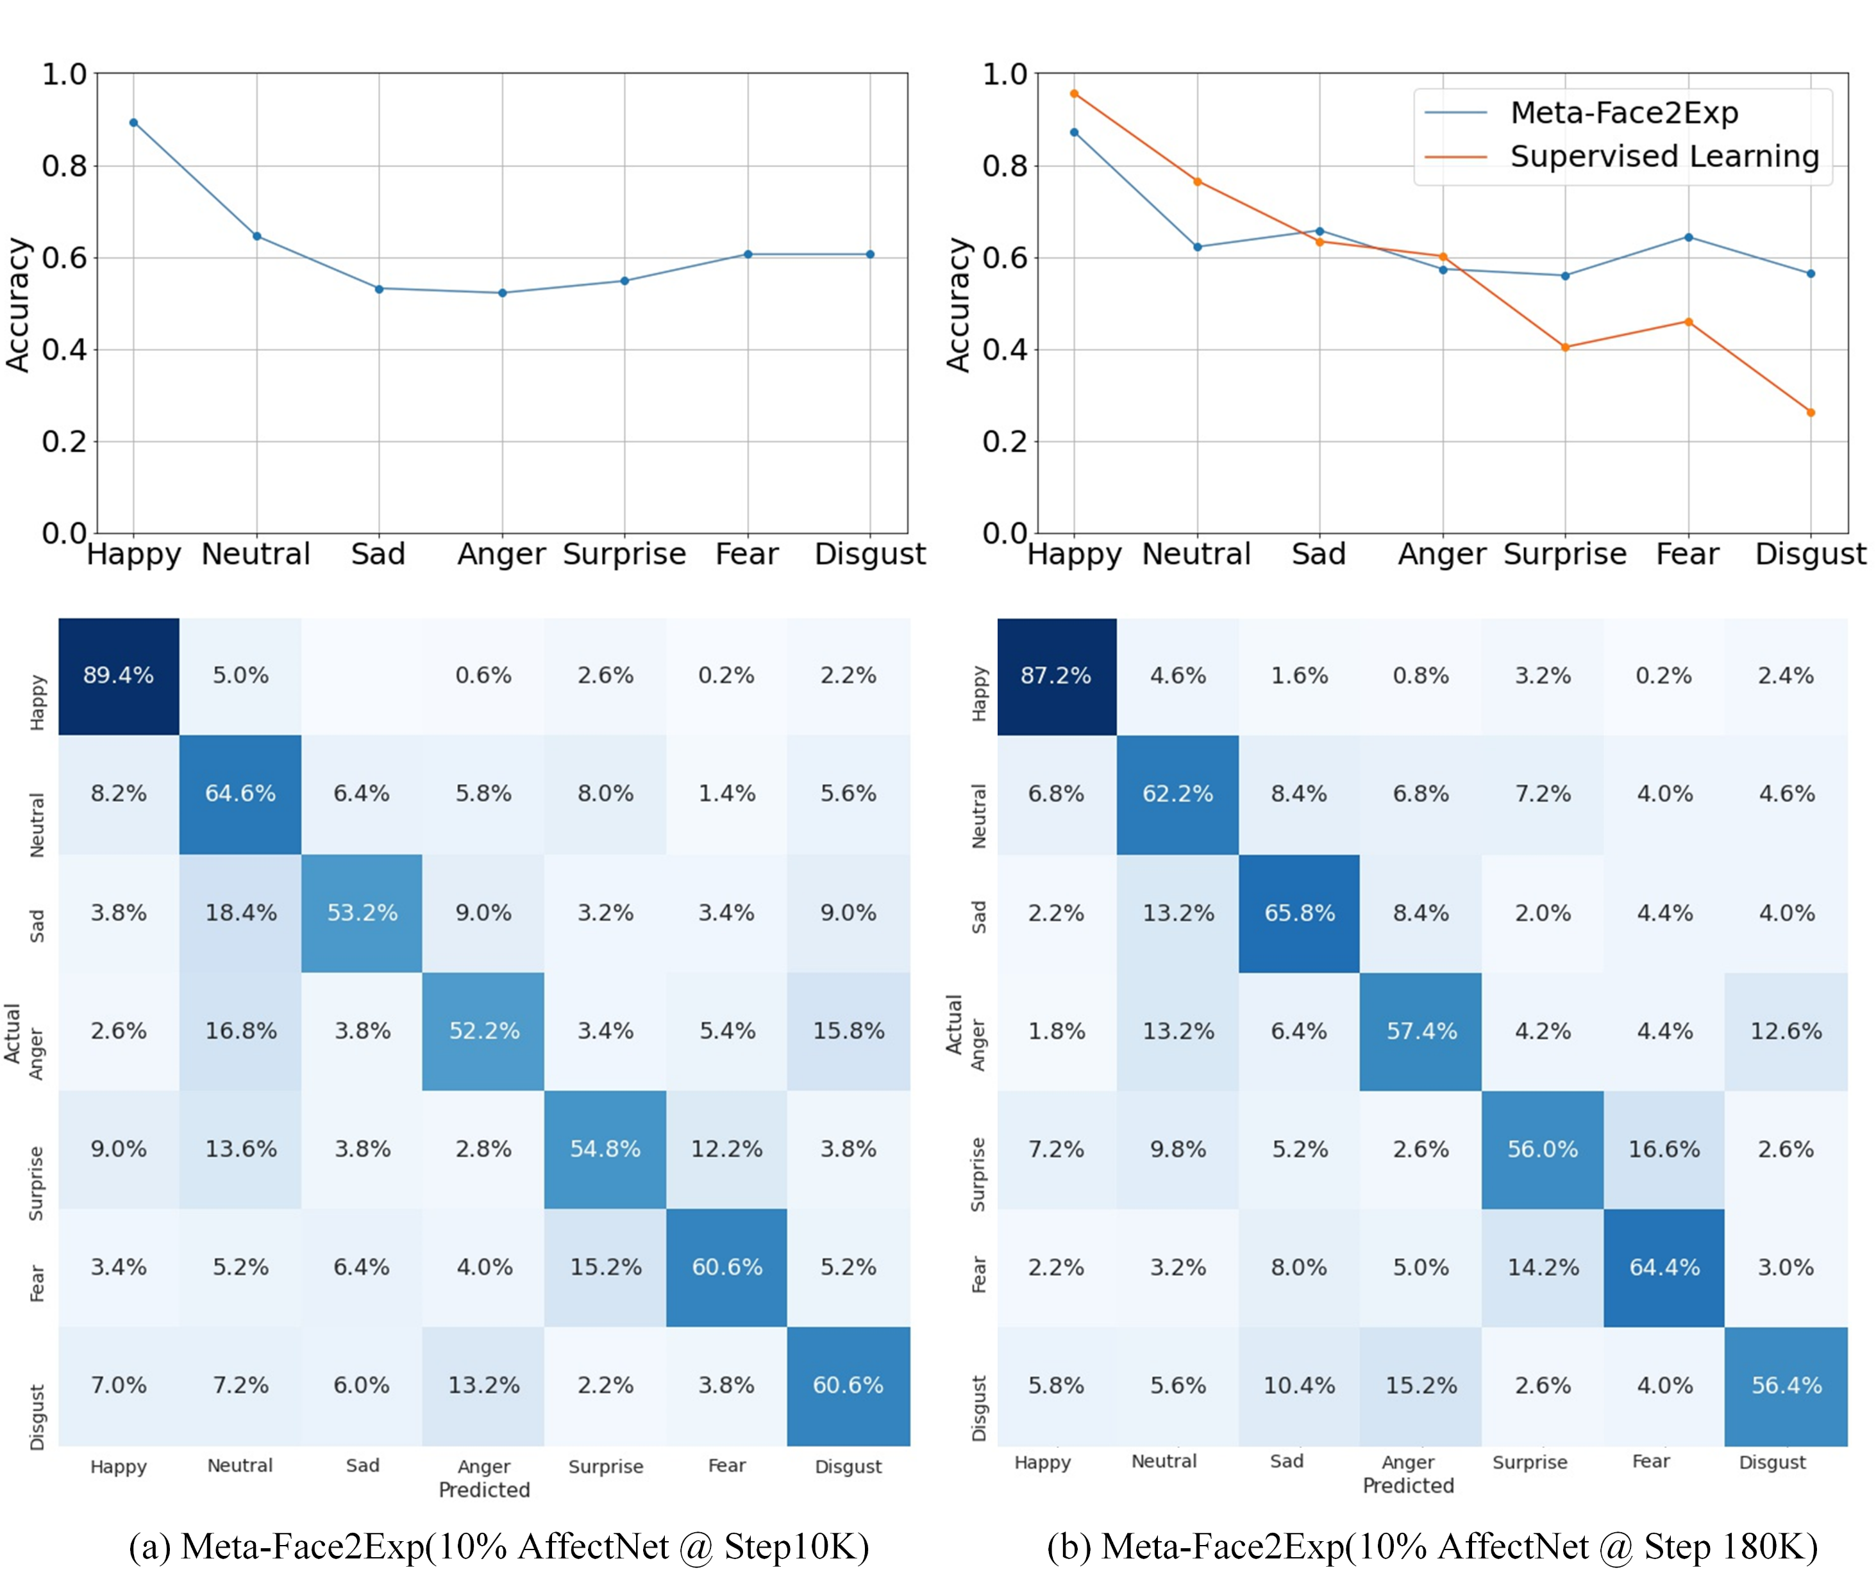
Evaluation on class imbalance
AffectNet: use 10% balanced FER data
De-biased behavior
Notes:
Here is an illustration of the de-biased behavior. We obtain more balance yet higher accuracy than supervised learning model.

Slide 17
Evaluation on class imbalance
Size of labeled data
AffectNet
RAF-DB
Models | SL | Meta-Face2Exp
Data size | 100% | 1% | 5% | 10%
Mean Acc | 58.37 | 53.54 | 61.66 | 64.23
Std Acc | 21.53 | 14.41 | 10.69 | 10.07
Models | SL | Meta-Face2Exp
Data size | 100% | 25% | 50% | 100%
Mean Acc | 84.16 | 80.87 | 85.04 | 88.54
Std Acc | 15.48 | 9.43 | 9.43 | 10.00
Notes:
We explore the effect of size of labeled data. First, our method achieves better mean accuracy than baselines by training with 5% AffectNet or 50% RAF-DB. (红框)

Slide 18
Evaluation on class imbalance
Size of labeled data
AffectNet
RAF-DB
Models | SL | Meta-Face2Exp
Data size | 100% | 1% | 5% | 10%
Mean Acc | 58.37 | 53.54 | 61.66 | 64.23
Std Acc | 21.53 | 14.41 | 10.69 | 10.07
Models | SL | Meta-Face2Exp
Data size | 100% | 25% | 50% | 100%
Mean Acc | 84.16 | 80.87 | 85.04 | 88.54
Std Acc | 15.48 | 9.43 | 9.43 | 10.00
Notes:
Second, our method can significantly reduce the std accuracy(高亮).

Slide 19
Conclusions
A general framework to utilize large unlabeled FR data for other face-related tasks (e.g., race/gender classification, age estimation) that lack high quality data
We combat data biases: class imbalance and distribution mismatch to extract de-biased knowledge through the circuit feedback mechanism
Our method can effectively produce low std and high mean accuracy with small labeled FER data
Notes:
Here is the take away. First, our method is a general framework for other face-related tasks. Second, we combat two data biases to extract de-biased knowledge through the circuit feedback mechanism. Last, we can effectively produce low std and high mean accuracy with small labeled FER data.

Slide 20


Please refer to our paper and the project page for more details and analyses: https://www.danzeng.org/about/ , https://github.com/danzeng1990/Face2Exp
Paper
Project page
Thanks for attention
Contact: zengd@sustech.edu.cn
Notes:
That’s all. Thanks for attention

